Slide 1
Digital Thinking and Innovation
Systems Thinking and Organizational Innovation

Slide 2
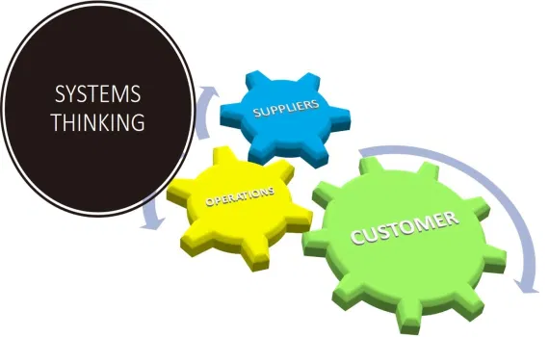
Introduction
This topic discusses about system thinking and where it leads today’s organizations on the changing ground.

Slide 3
Learning Outcomes for the Lecture
At the end of this lecture you will be able to:
Explain system thinking
Determine the characteristics of a system
Discuss how system thinking can shape the future of today’s organization

Slide 4
Content
Systems Thinking
Basic Characteristics of a System
Systems Thinking for Today’s Organizations
Unlocking the Sustainable Development Goals

Slide 5
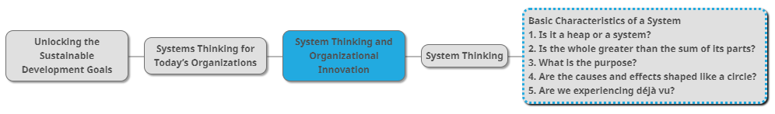
Mind Map

Slide 6
Introduction
What is Culture?
Define/Describe Culture?
Define/Describe/Cultural change ?
Describe ‘Digital Dependency’?

Slide 7
Introduction
What is Culture?
Symbolic acceptance of communication and way of life by the community.
Define/Describe Culture?
A way of life of a group of people– the behaviors, beliefs and values that they accept without thinking much about them, and that are passed along by communication and imitation from one generation to the next.
Define/Describe/Cultural change ?
Cultural change can occur from within through new philosophical ideas or technological advancement.

Slide 8
Introduction
Describe ‘Digital Dependency’?

Slide 9
Introduction
Describe ‘Digital Dependency’?
The overuse of the internet or electronics to the point that one's daily life is affected.

Slide 10
Systems Thinking
Systems thinking is an approach to integration that is based on the belief that the component parts of a system will act differently when isolated from the system’s environment or other parts of the system.
Systems thinking concerns an understanding of a system by examining the linkages and interactions between the elements that comprise the whole of the system.

Slide 11
Systems Thinking
Systems thinking is not analysis
Where the best way to understand something is to break it down into bite-size, manageable pieces
The problem arises when we use analysis mindlessly, assuming:
The world stands still as we study it
Puzzling situations will stand still while we break them into their component pieces
The relationships between the pieces aren’t important.

Slide 12
Systems Thinking
Analysis therefore gives us a limited understanding of reality
Complementing analytical thinking with system thinking to help us expand our understanding
See the world around us in terms of wholes, rather than as single events, or “snapshots” of life;
See and sense how the parts of systems work together, rather than just see the parts as a collection of unrelated pieces;

Slide 13
Systems Thinking
See how the relationships between the elements in a system influence the patterns of behavior and events to which we react;
Understand that life is always moving and changing, rather than static;
Understand how one event can influence another—even if the second event occurs a long time after the first, and “far away” from the first;
Know that what we see happening around us depends on where we are in the system;

Slide 14

Systems Thinking
Challenge our own assumptions about how the world works (our mental models)—and become aware of how they limit us;
Think about both the long-term and the short-term impact of our and others’ actions;
Ask probing questions when things don’t turn out the way we planned.
In short: Systems thinking is a powerful approach to understand the nature of why situations are the way they are AND how to go improve results

Slide 15
“Surviving” Skill
We try to make sense of the phenomena we perceive around us and our environment
We then use our explanations to predict what may happen in the future
Yet our explanations often contain misconceptions about causes and outcomes and incomplete or overly simple assumptions about how the world works
When this happens, we struggle again and again with what seem like the same problems

Slide 16
“Surviving” Skill
We take actions that we think will address fundamental problems, but often they never do, or they actually make the original problem worse.
How do we get off this problem-solving treadmill?
Systems thinking can help

Slide 17

Group Discussion
Watch and discuss the content of the video:
https://www.youtube.com/watch?v=GPW0j2Bo_eY

Slide 18
Basic Characteristics of a System
The following five questions can get you started to understand the basic characteristic of a system:
Is it a heap or a system?
Is the whole greater than the sum of its parts?
What is the purpose?
Are the causes and effects shaped like a circle?
Are we experiencing déjà vu?

Slide 19
1. Is It a Heap or a System?
Both heap and system consist of two or more parts.
With a heap, nothing changes if you take away or add parts.
For instance, imagine that you have a bowl of nuts. What happens if you remove all the cashews or add hazel- nuts? Answer: You still have just a bowl of nuts.
With a system, things definitely change if you take away or add parts.
For example, suppose you removed the battery from your car. The car wouldn’t start! A car is an example of a mechanical system.

Slide 20
2. Is the Whole Greater Than the Sum of Its Parts?
In systems thinking, this means that the many interactions among the parts in a system give rise to qualities or properties that you just can’t measure merely by adding up those parts
Example:
For anyone who has played team sports, it echoes the T.E.A.M. acronym—Together, Everyone Achieves More

Slide 21
2. Is the Whole Greater Than the Sum of Its Parts?
Another Example:
Assume you completely took the car apart.
If you weighed all the pieces and added up the numbers, you’d know how much the entire car weighs when it’s assembled correctly.
But you wouldn’t know how fast the car goes or how comfortable a ride you’d have on a bumpy road. Speed and comfort are created by the interactions of the car’s parts and thus are “greater than the sum” of all the car’s separate parts.
Speed and comfort are the emergent properties

Slide 22
3. What is the Purpose?
Most systems have a distinct “point,” or purpose in relationship to the larger system in which they are embedded.
In many social systems, we see subsystems whose purposes can conflict sometimes. Example: teacher sometimes be at cross-purposes with the guidance department, or with the administration.

Slide 23
3. What is the Purpose?
We often forget to ask this: “What is the purpose of this system?”
By understanding the various and sometimes conflicting purposes within a system, you can begin gaining insight into why the system functions as it does, and how you might help it function better.
Back to previous example: Regular meetings between teachers and school administrators might help them clear up conflicts.

Slide 24
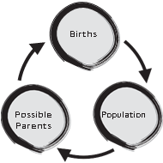
4. Are the Causes and Effects Shaped Like a Circle?
Systems thinkers’ notion of causality: feedback loops.
The simplest way to think of these is to imagine that one event causes another event, and that second event comes back around to influence that first cause. It’s like this: A causes B, B causes C, and C causes A.

Slide 25
5. Are We Experiencing Déjà Vu?
Another interesting thing about systems is that they tend to behave in similar ways in very different kinds of settings.
For instance, one bully insults another, who then comes back with an even more inflammatory retort. The next thing you know, someone throws a punch—and an all-out brawl erupts.
Now think of companies competing in the business world. One draws more customers by slashing prices. Its main competitor, concerned about being left behind, slashes its prices even more—prompting the first company to try to offer even lower prices.

Slide 26
5. Are We Experiencing Déjà Vu?
Even though the two situations look very different on the surface, both involve a build-up, or an escalation, of tensions or competitiveness.
Systems thinkers have identified a whole set of common “stories” like this, which they call “systems archetypes”

Slide 27
Systems Thinking for Today’s Organizations
Systems thinking encourages practitioners to understand and analyse the contexts within which they operate
Allowing to design programmes as conditions on the ground change
Helps practitioners bring together different stakeholders, especially with radically different backgrounds and perspectives
Easy to identify problems, increasing transformational change
Benefits are:
explore new business opportunities
create compelling vision of the future
understand the complex human factors associated with change
re-design broken systems.

Slide 28
Unlocking the Sustainable Development Goals
For organizations rising to the challenge, that means operating on three levels:
Level 1: Joined-up efforts on individual goals
If you want to fast, go alone; if you want to go further, go together
Level 2: A ‘network set’ of goals
Looking at the inter-relationships between all the goals
Level 3: The ‘how’ of sustainable development
Delivering the goals in a way that models the characteristics we need for a sustainable society

Slide 29
Summary
System Thinking
Basic Characteristics of a System
Systems Thinking for Today’s Organizations
Unlocking the Sustainable Development Goals

Slide 30
Questions and Answer
Q & A

Slide 31

Next Lecture
Innovation in Digital Trends

